Slide 1
Odometer Detection
for Sonic Automotives
Jay Chamma, Janani Rammohan, Jaissruti Nanthakumar, Daysean Scott
Group 8

Slide 2
Introduction
Jaissruti & Janani
Dataset collection, pre - processing, creating bounding boxes by identifying odometer in the dashboard
Daysean
Research, worked on improving testing scores
Jay
Developed the final solution

Slide 3
Problem & Motivation
Our problem consists of detecting the mileage number in an image of a car’s odometer dashboard.
We wanted to tackle this problem since it was tied to a real-life scenario where a business could actually benefit from a viable solution.

Slide 4
Challenges
1.Images from the dataset may be difficult to process because of insufficient lighting,incorrect orientation and low picture resolution.
2.Differentiating mileage from other information such as temperature, time and fuel status is difficult.
3.Large number of images should be available for proper implementation of the model.

Slide 5
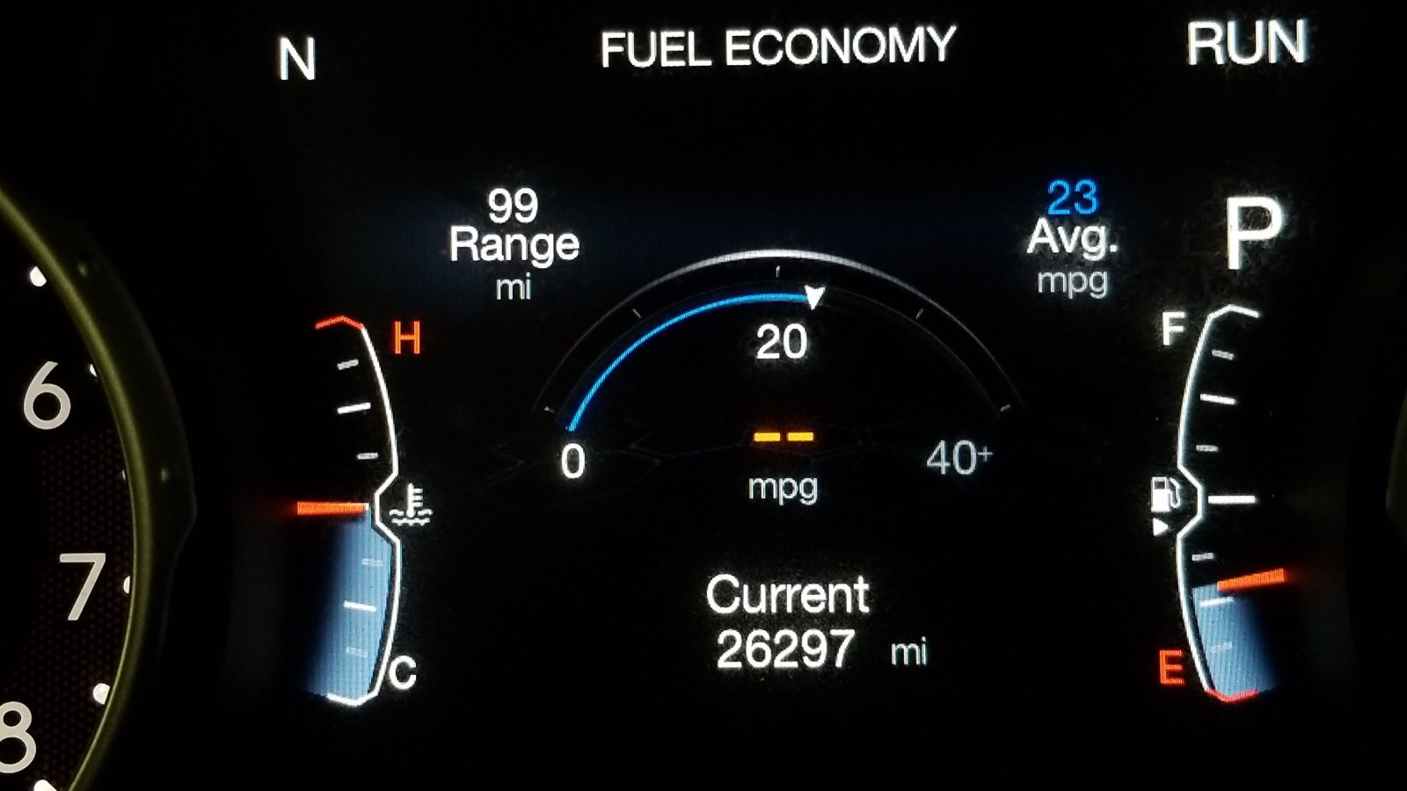
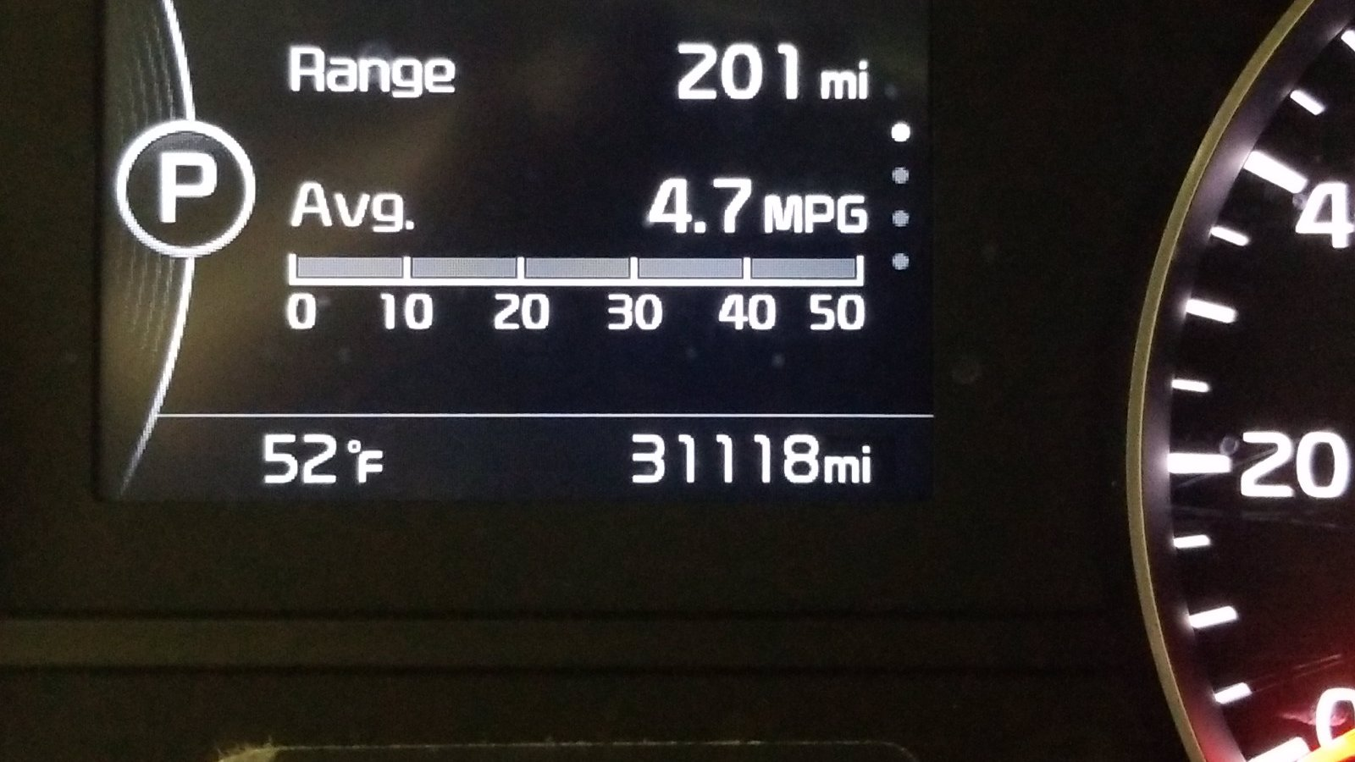
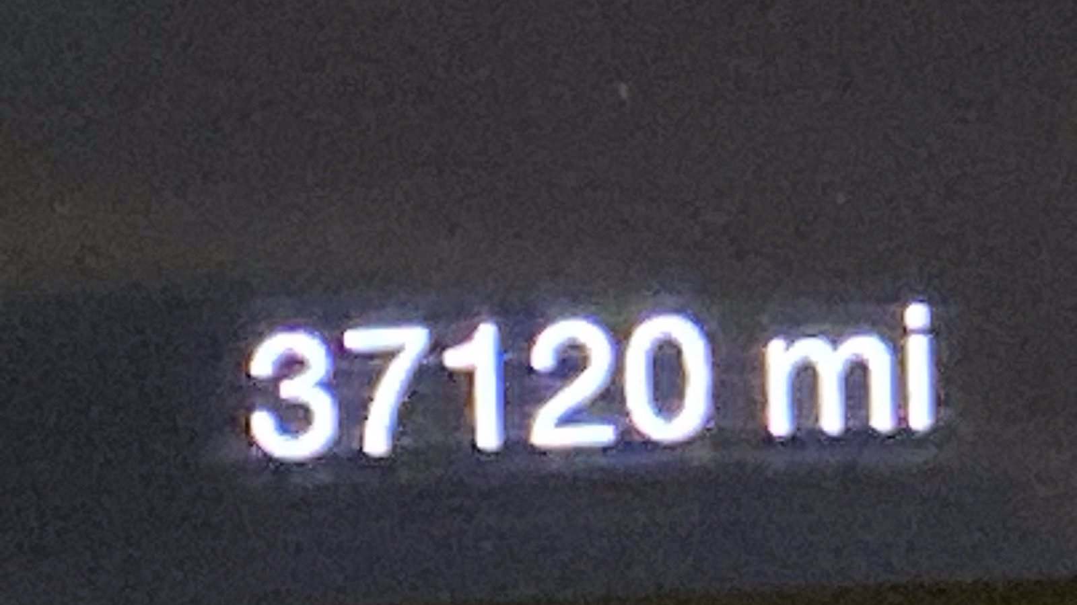
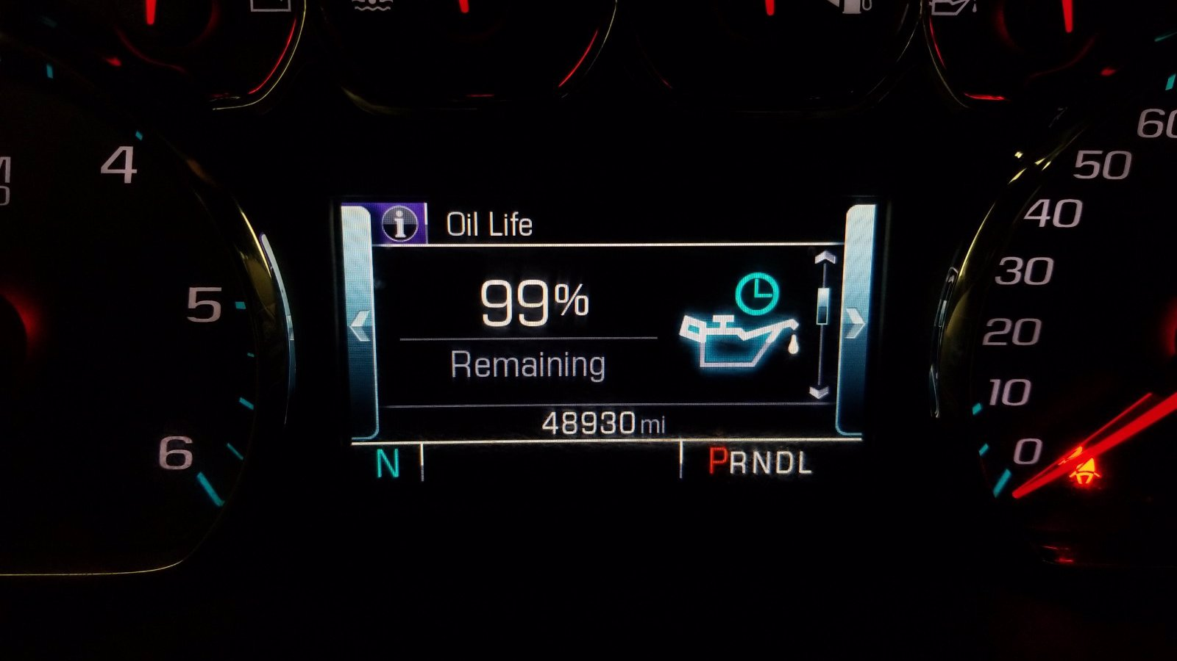
The Dataset

Slide 6
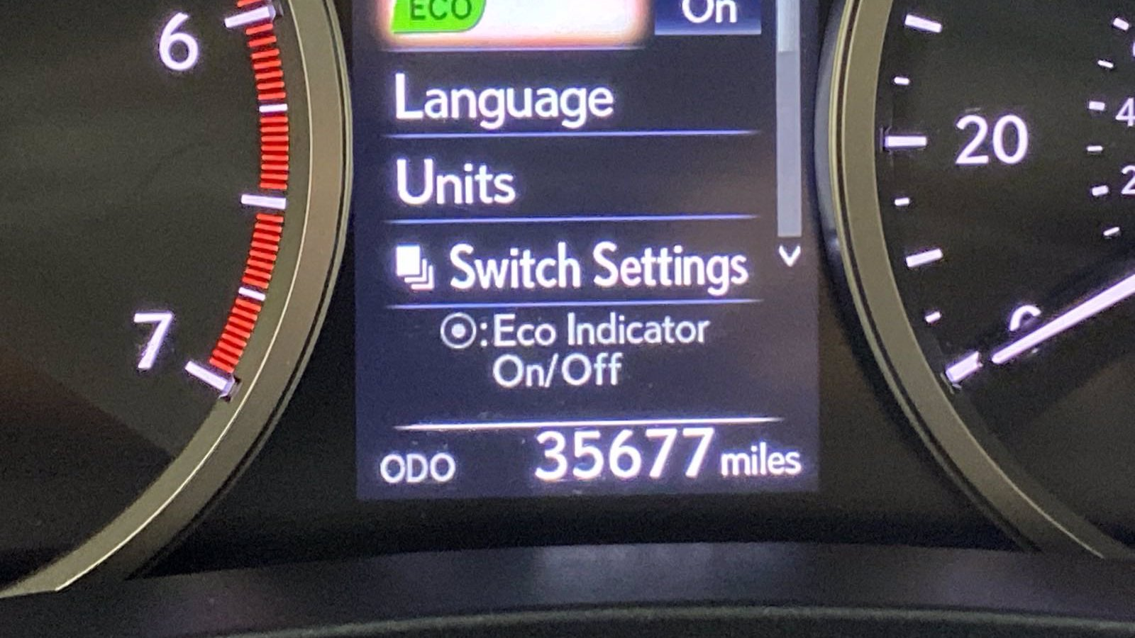
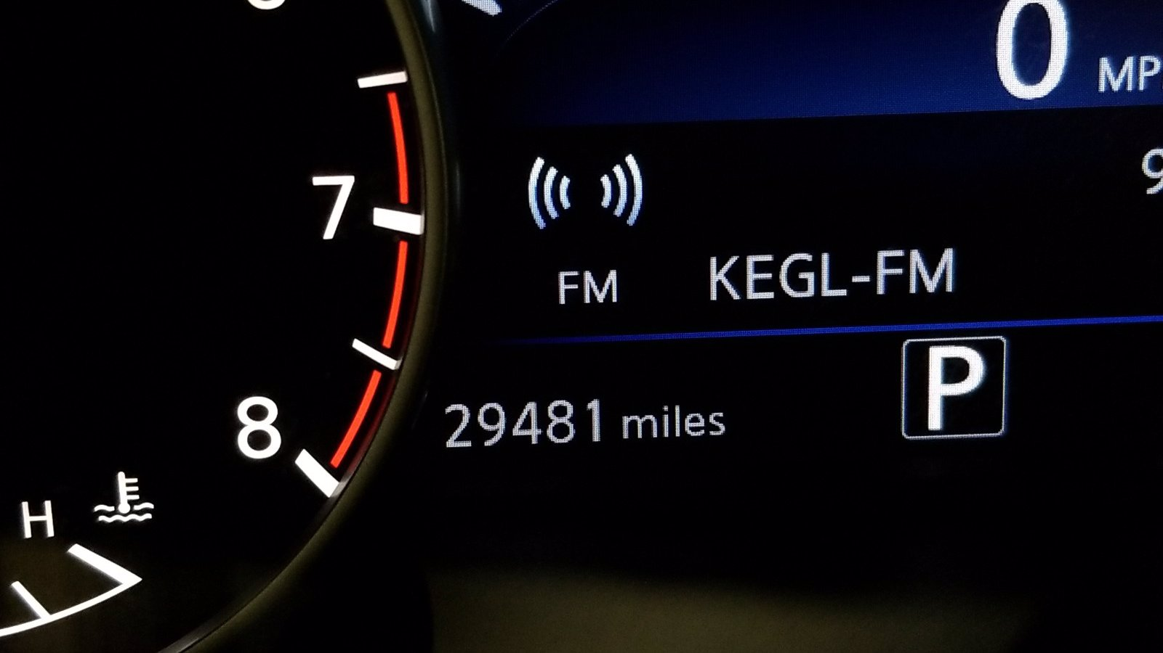
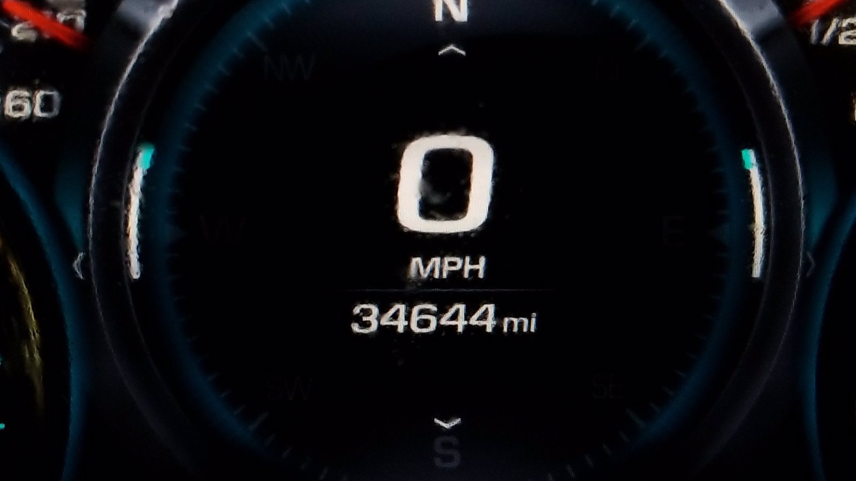
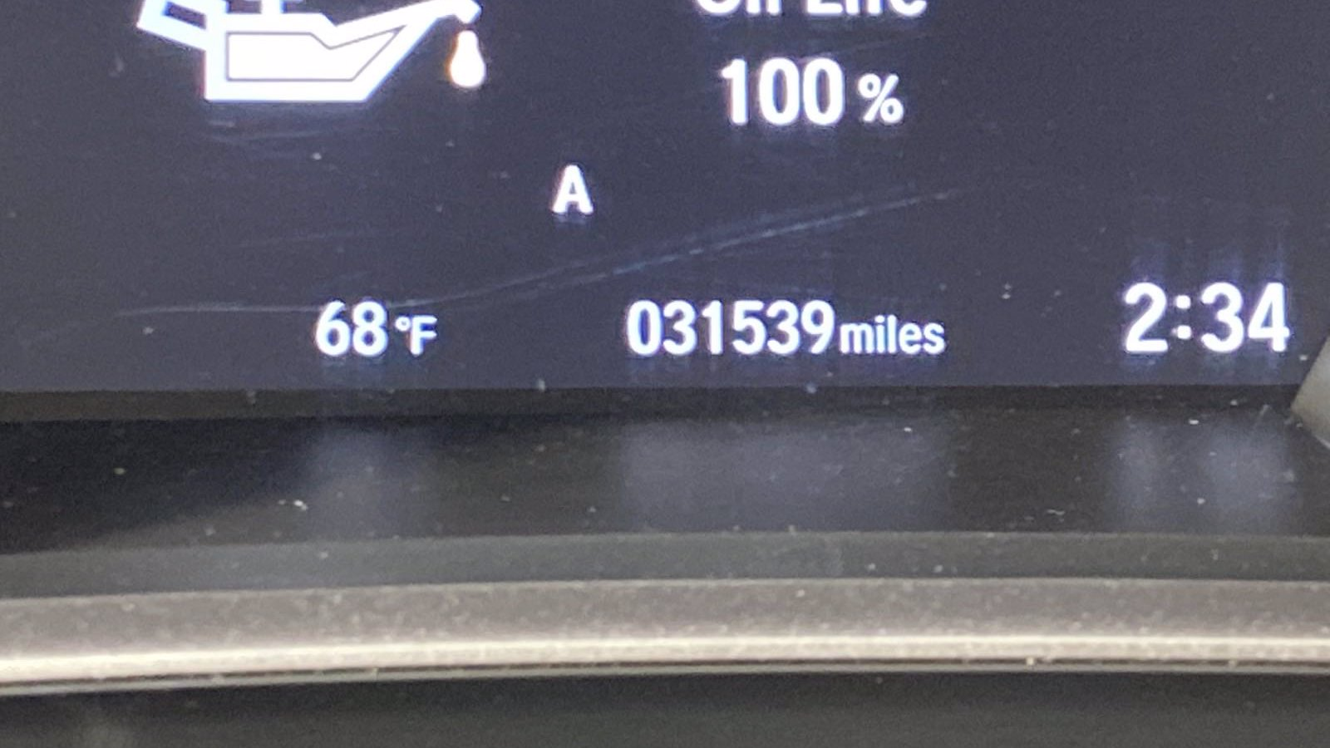

Slide 7
Pre-processing - Training Dataset(TRODO)
The TRODO dataset has approximately 2500 images with a mix of both digital and analog odometer images.
We tried to create a csv file containing the coordinate values of odometer reading of all the images.
It is done by manually marking the coordinates of the odometer value in the dashboard of the car.
Since this was a tedious process, we thought of creating bounding boxes using yolov3.

Slide 8
Bounding boxes detection
The TRODO dataset has a file containing xmin, ymin, xmax and ymax values.
From which, the bounding box of odometer is created by passing the values to each image.
We were able to get clear bounding box captured only for mileage of the car. But, this was possible only for the analog odometer images

Slide 9
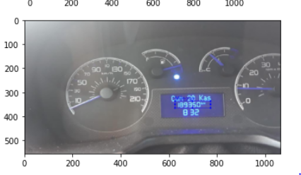
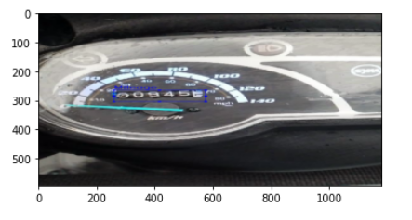
Bounding box for analog odometer images

Slide 10
Limitations of TRODO dataset
The limitation of this step is, for digital odometer images, the bounding box contains all the external details of the dashboard including the odometer part which makes it hard to eliminate the unwanted details such as time, speed and miles to gas station etc.
For digital odometer detection, we were not able to achieve the correct bounding box detection.

Slide 11
Final Implementation
Can we solve this without having to train a neural network?
Yes, we can!
Our final implementation:
Step 1: Apply EasyOCR to read the entire image
Step 2: Determine which are valid detections
Step 3: Return the detection of maximum likelihood

Slide 12
Find detections with label ‘mi’ or ‘km’
found
Not found
Clean & Check for a valid mileage
valid
invalid
Find the maximum valid number in image
Return the number
found
Not Found
Return the number
Return “notFound”

Slide 13
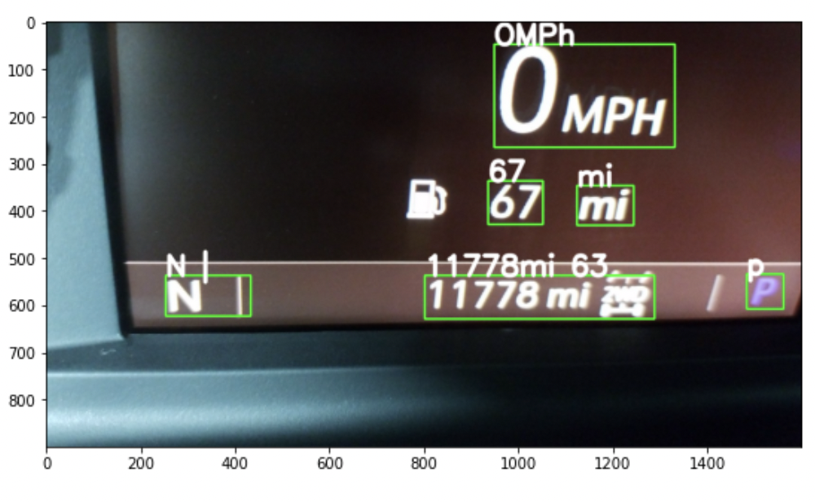
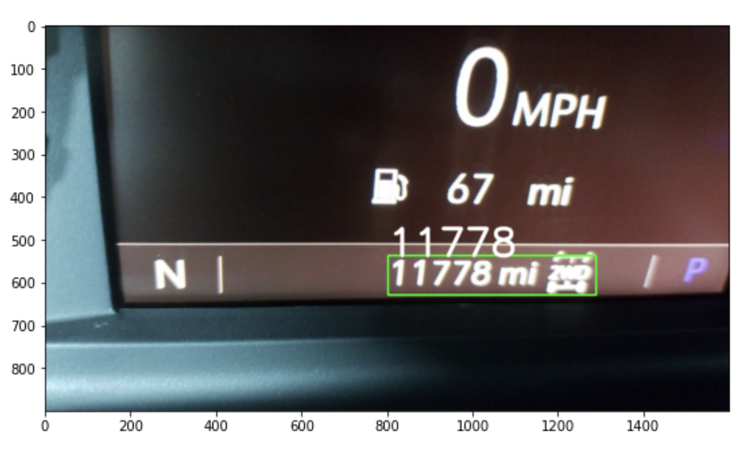
Results

Slide 14
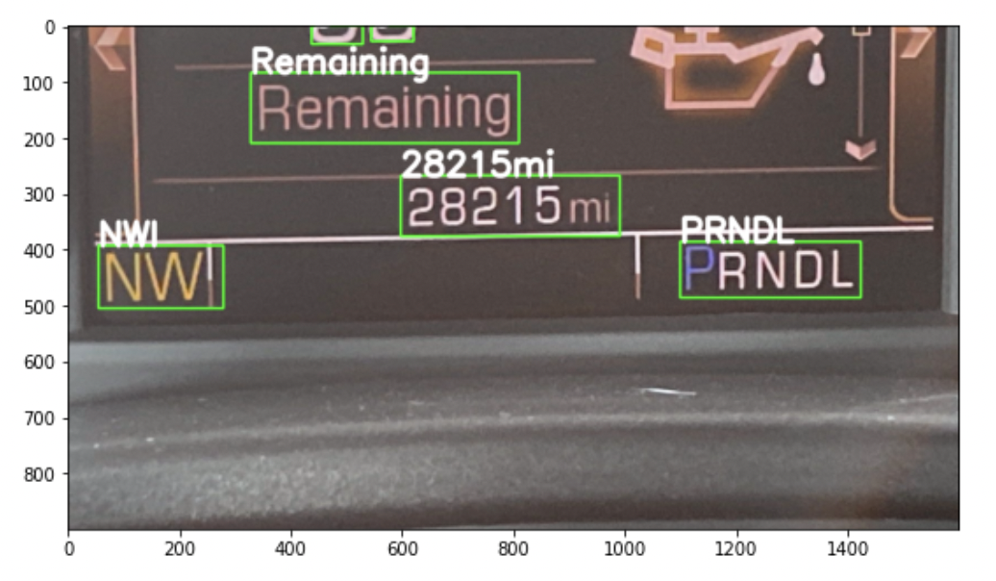

Slide 15
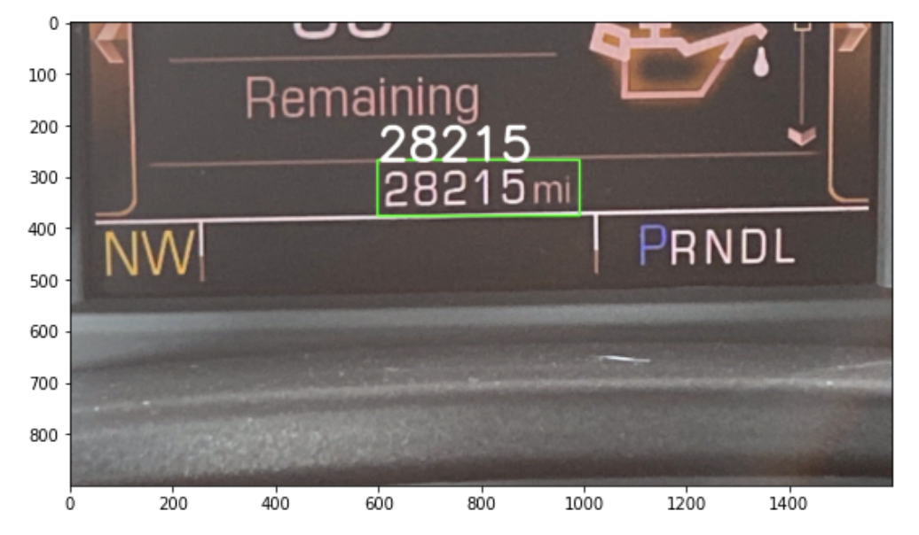

Slide 16
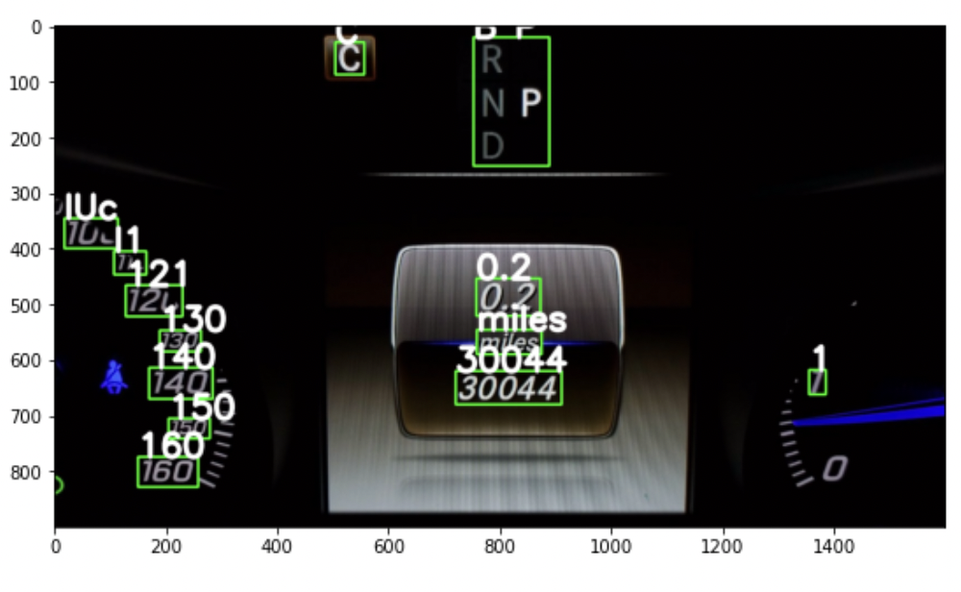

Slide 17
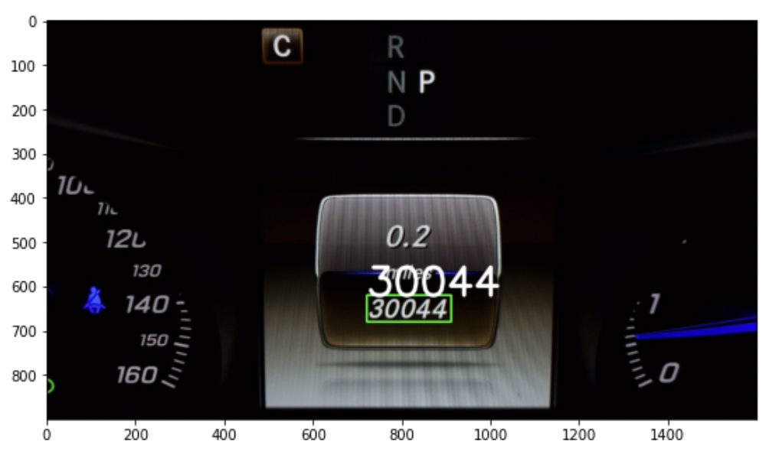

Slide 18
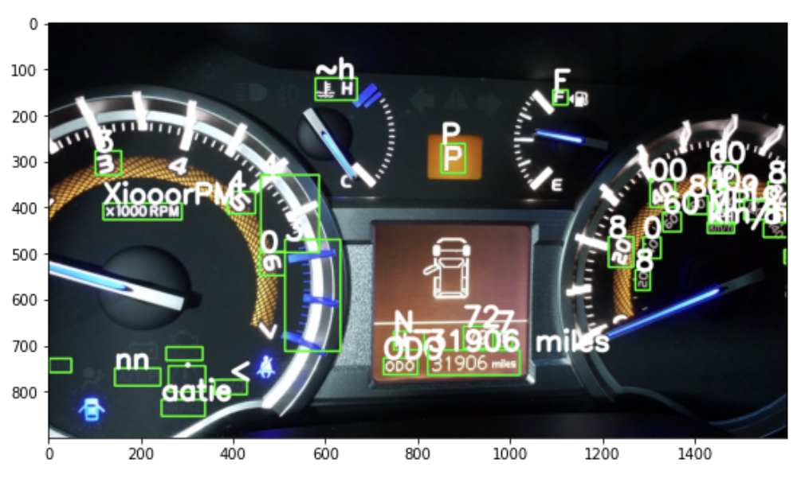

Slide 19
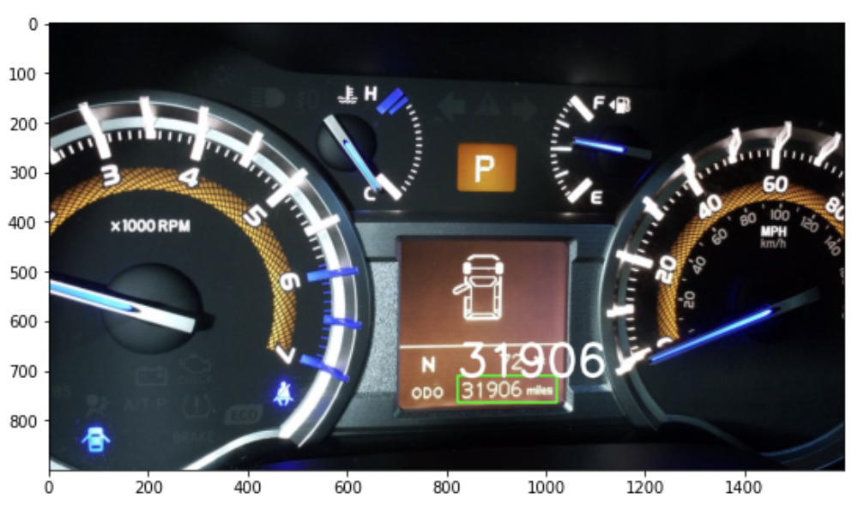

Slide 20
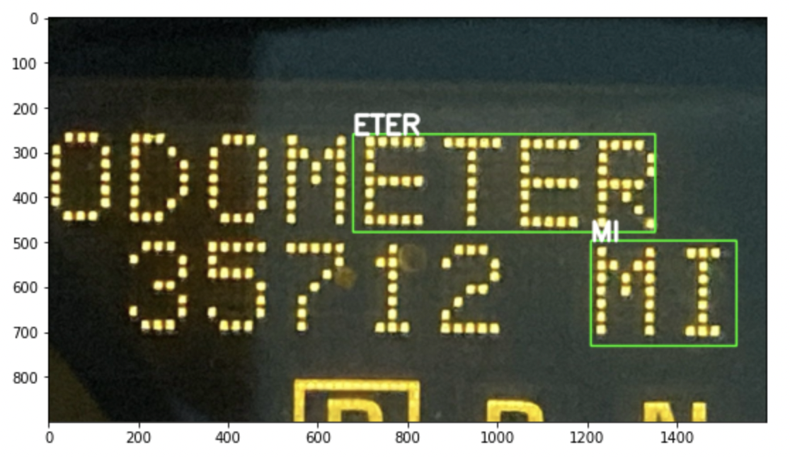
Incorrect EasyOCR Reading

Slide 21
Accuracy / Precision / Recall
Total Images = 113 images Correct predictions = 98 images
Accuracy TP+TN / ALL 98 + 0 / 113 87 %
Precision TP / TP+FP 98 / 98 + 12 89 %
Recall TP / TP+FN 98 / 98 + 3 97 %
Limitations of our solution:
Assumption that the mileage is the highest number found in the image if the initial step of finding numbers with labels fails.
Potential of our solution:
If EasyOCR is able to read every image correctly, our solution is expected to have an accuracy of 99%
Link to collab: https://colab.research.google.com/drive/1-f1-ER01Ot6XDekkJ2sS3DiaLhdTgQGc?usp=sharing

Slide 22
Conclusion
Our solution consisted of the following steps:
Utilizing an Optical Character Recognition tool to read the entire image
Examining all detections to determine which of them are valid
Clean up the valid detection text
Return the detection with the highest likelihood of being the mileage.

Slide 23
Thank you!

